Slide 1


What is investment?
Financial investment, speculation and saving
Lesson 1
Investment and Financial Decision-Making
Grade 9
Notes:
Timing: 0:00–0:30
Teacher move: Have the four-page handout open on desks. Do not begin with a definition; move immediately to the same-asset dilemma.
[Sources]
- C:/Users/oehle/Documents/oehler-huang-platform/apps/library/investment-analysis/handouts/Investment Version 24.docx
- C:/Users/oehle/Documents/presentations/teaching-standards/outputs/Systematically_Improving_Teaching_2026_v3.pptx
- Pexels / RDNE Stock project: https://www.pexels.com/photo/white-papers-on-the-table-7821708/
[/Sources]

Slide 2
01
Two people buy the same shares.
Can one be investing
while the other is speculating?
Notes:
Timing: 0:30–3:00
Teacher move: Students write an initial yes/no judgement and one reason in their notebooks. Take two contrasting answers without confirming the result.
[Sources]
- C:/Users/oehle/Documents/oehler-huang-platform/apps/library/investment-analysis/handouts/Investment Version 24.docx
- C:/Users/oehle/Documents/oehler-huang-platform/apps/library/investment-analysis/course-map-financial-decisions-data.js
[/Sources]

Slide 3
Three decisions to make accurately
1
2
3
DISTINGUISH
financial investment
(金融投资)
speculation (投机)
saving (储蓄)
CLASSIFY
purpose
payoff basis (回报依据)
liquidity (流动性)
JUSTIFY
one decisive clue
+ reject the nearest
category
Notes:
Timing: 3:00–4:00
Teacher move: Read only the three action verbs. Students underline the three difficult terms and their Chinese translations on the handout.
[Sources]
- C:/Users/oehle/Documents/oehler-huang-platform/apps/library/investment-analysis/handouts/Investment Version 24.docx
[/Sources]

Slide 4
Three money decisions
Notes:
Timing: 4:00–4:20
Teacher move: Signal the structure: investment first, then the two boundaries that prevent misclassification.
[Sources]
- C:/Users/oehle/Documents/oehler-huang-platform/apps/library/investment-analysis/handouts/Investment Version 24.docx
[/Sources]

Slide 5

Financial investment seeks return—not certainty
1/3
Financial investment (金融投资)
Putting money into an asset (资产) to seek future total return (总回报).
Evidence can support the expectation.
Possible loss (可能亏损) remains.
Photo: Investment Analysis visual archive.
Notes:
Timing: 4:20–7:00
Teacher move: Students locate the definition on page 1. Ask: What is being sought? What remains possible? Stress that evidence improves a judgement; it does not guarantee profit.
[Sources]
- C:/Users/oehle/Documents/oehler-huang-platform/apps/library/investment-analysis/handouts/Investment Version 24.docx
- C:/Users/oehle/Documents/oehler-huang-platform/apps/library/assets/images/investment-analysis/business-charts-paper-2021.jpg
[/Sources]

Slide 6
Total return (总回报) = income + change in market value (市场价值)
1
+
2
INCOME
interest · dividends (股息) · net rent (净租金)
PLUS
both parts count over the same period
VALUE CHANGE
capital gain (资本利得) or capital loss (资本损失)
Notes:
Timing: 7:00–9:00
Teacher move: Students copy only the equation into notebooks. Check that income and value change refer to the same period and that value change can be negative.
[Sources]
- C:/Users/oehle/Documents/oehler-huang-platform/apps/library/investment-analysis/handouts/Investment Version 24.docx
[/Sources]

Slide 7
The asset changes the return—and the loss route
STOCKS (股票)
Dividends + change in share price
PROPERTY (房地产)
Net rental income + change in property value
1
3
LOSS ROUTE
Price fall; dividend cut or omitted
LOSS ROUTE
Vacancy, costs or lower sale price
!
!
BONDS (债券)
Coupon interest (票息) + change in bond price
INDEX FUND (指数基金)
Distributions (分配收益) + change in fund value
2
4
LOSS ROUTE
Missed payments, default (违约) or lower sale price
LOSS ROUTE
Fees and a fall in market value
!
!
Possible capital gain is never guaranteed.
Notes:
Timing: 9:00–11:00
Teacher move: Use the grid as a fast oral contrast. Students point to one income source and one loss route. Avoid implying that every asset must provide income.
[Sources]
- C:/Users/oehle/Documents/oehler-huang-platform/apps/library/investment-analysis/handouts/Investment Version 24.docx
[/Sources]

Slide 8
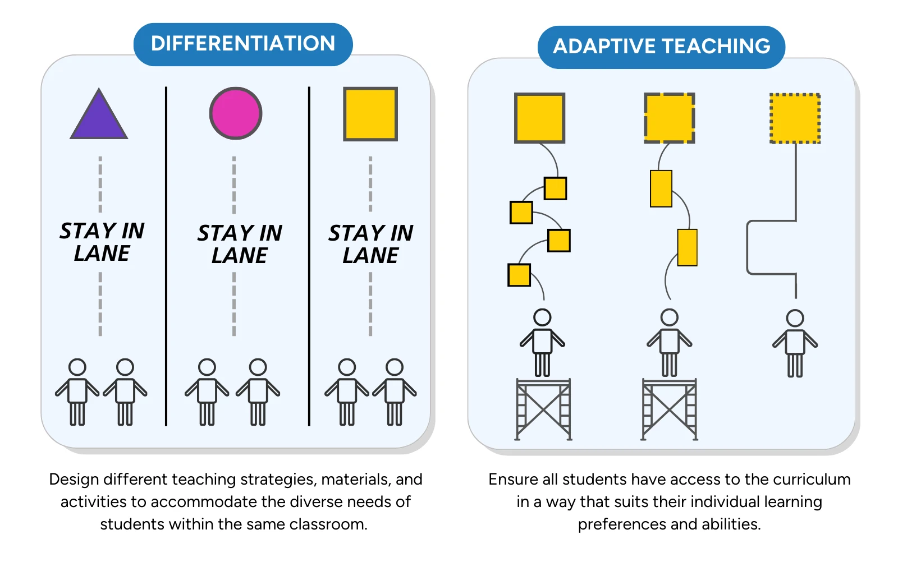
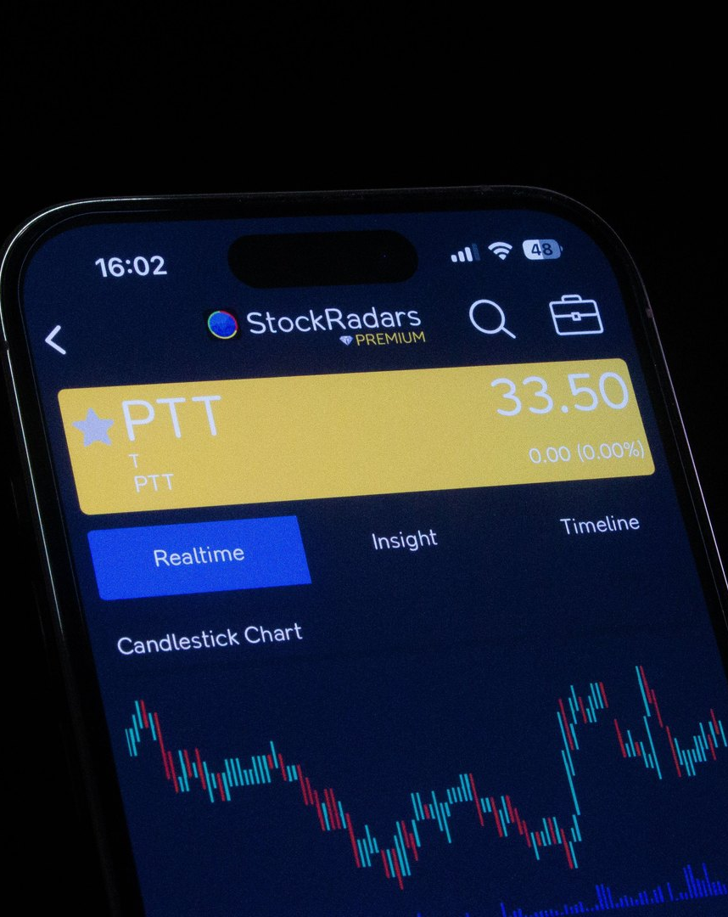
Speculation depends mainly on a price prediction
2/3
Speculation (投机)
Trading mainly to gain from a predicted price change (预测的价格变动).
Income or underlying value (基础价值) is not the main basis.
Careful research can still support speculation.
Photo: StockRadars Co. / Pexels.
Notes:
Timing: 11:00–14:00
Teacher move: Ask what the trader expects to cause the gain. Correct the misconception that careful research automatically makes a trade an investment.
[Sources]
- C:/Users/oehle/Documents/oehler-huang-platform/apps/library/investment-analysis/handouts/Investment Version 24.docx
- Pexels / StockRadars Co.: https://www.pexels.com/photo/smartphone-displaying-stock-trading-app-interface-28682345/
[/Sources]

Slide 9

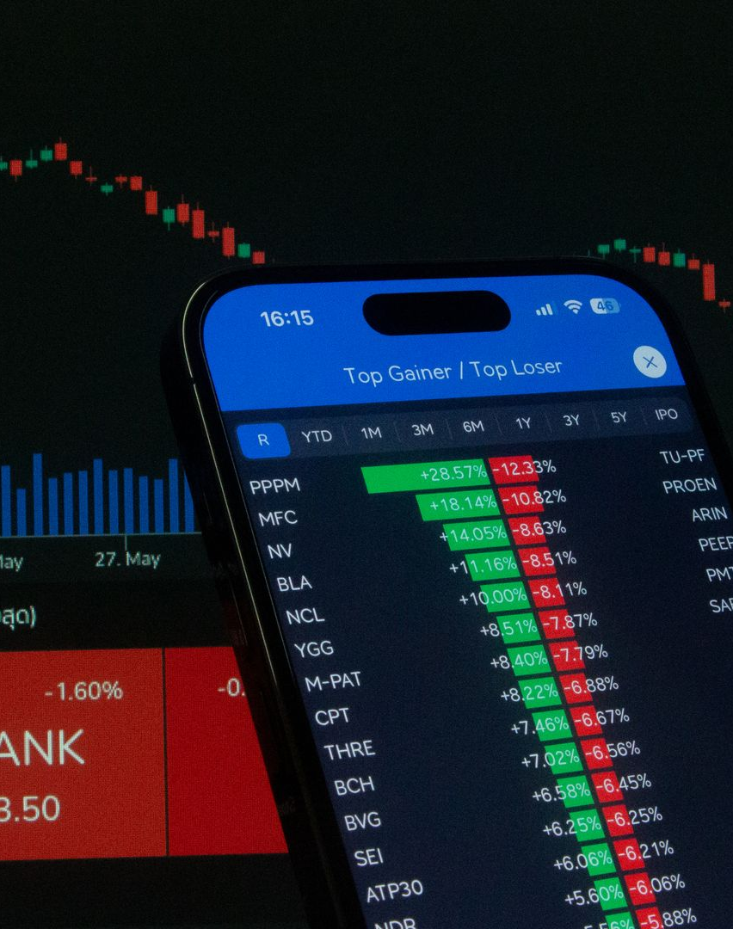
Expected payoff basis (预期回报依据) separates the decisions
Financial investment (金融投资)
Expected income and/or evidence about underlying value (基础价值).
Possible loss is accepted.
Speculation (投机)
Predicted price change is the main basis.
Research quality alone does not decide the category.
Notes:
Timing: 14:00–17:00
Teacher move: Students read both bands, then complete the investment-versus-speculation comparison on the handout. Cold-call one student for the decisive contrast.
[Sources]
- C:/Users/oehle/Documents/oehler-huang-platform/apps/library/investment-analysis/handouts/Investment Version 24.docx
- Pexels / StockRadars Co.: https://www.pexels.com/photo/smartphone-displaying-stock-market-data-28682351/
[/Sources]

Slide 10

The same shares can support two different decisions
INVESTOR →
dividends + evidence about long-term value
SPECULATOR ←
predicted price move after an announcement
Notes:
Timing: 17:00–18:30
Teacher move: Return briefly to the hook. Ask which words classify each decision. Reject answers based only on the word shares.
[Sources]
- C:/Users/oehle/Documents/oehler-huang-platform/apps/library/investment-analysis/handouts/Investment Version 24.docx
[/Sources]

Slide 11
“The asset does not decide the category.”
Classify by the main purpose and expected payoff basis (预期回报依据).
Notes:
Timing: 18:30–20:00
Teacher move: Students write the sentence in notebooks. Ask for one asset that could be used for either investment or speculation.
[Sources]
- C:/Users/oehle/Documents/oehler-huang-platform/apps/library/investment-analysis/handouts/Investment Version 24.docx
[/Sources]

Slide 12
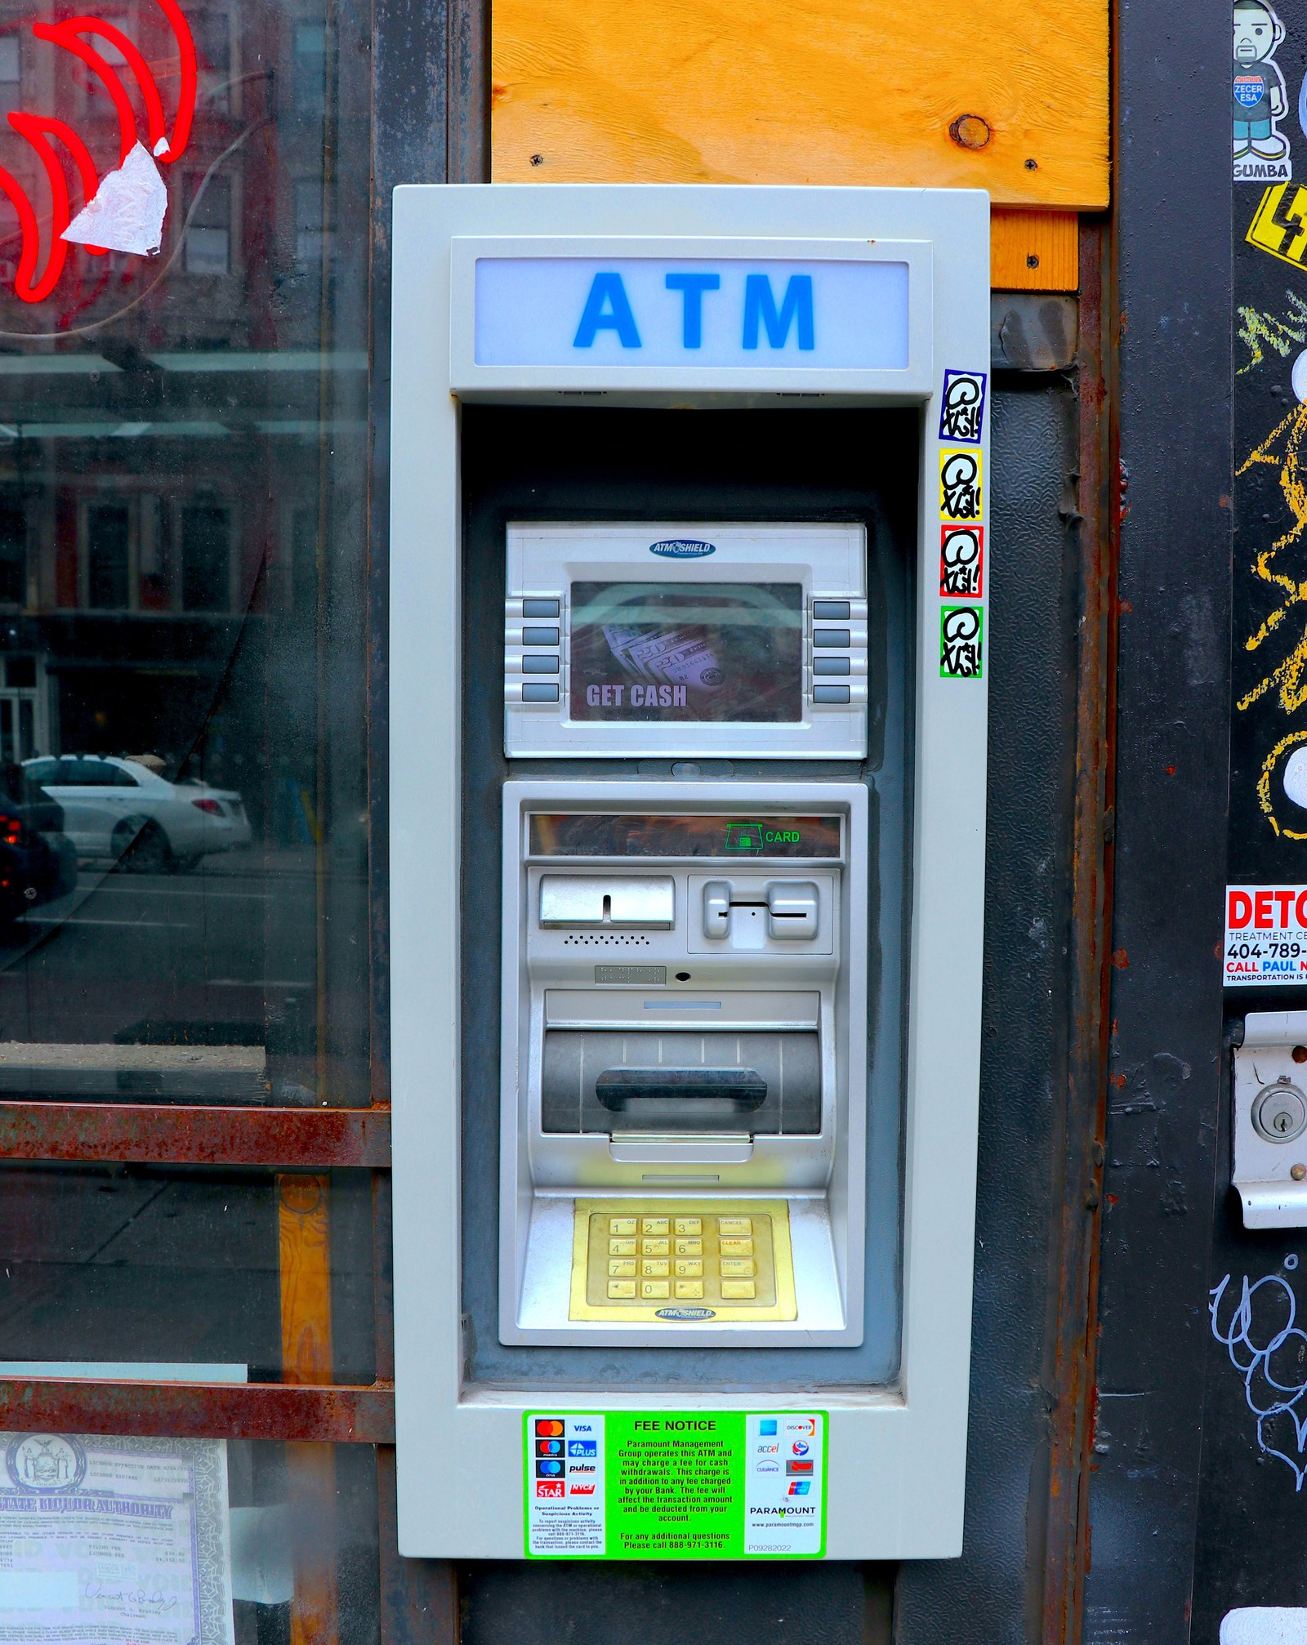
Saving prioritises safety and access
3/3
Saving (储蓄)
Current income not spent now.
Capital preservation (保本) and liquidity (流动性) matter most.
Interest does not automatically make saving a financial investment.
Photo: Investment Analysis visual archive.
Notes:
Timing: 20:00–22:30
Teacher move: Contrast purpose, not just the account label. Ask why money for an emergency fund may remain saving even when a bank pays interest.
[Sources]
- C:/Users/oehle/Documents/oehler-huang-platform/apps/library/investment-analysis/handouts/Investment Version 24.docx
- C:/Users/oehle/Documents/oehler-huang-platform/apps/library/assets/images/investment-analysis/lesson-1/access-public-atm-2024.jpg
[/Sources]

Slide 13
02
What is the money mainly for?
Where should the payoff come from?
How important are safety and ready access?
Notes:
Timing: 22:30–24:00
Teacher move: Students use the three questions as a spoken classification routine. Emphasise mainly: a decision can have more than one feature, so identify the dominant purpose and basis.
[Sources]
- C:/Users/oehle/Documents/oehler-huang-platform/apps/library/investment-analysis/handouts/Investment Version 24.docx
[/Sources]

Slide 14
Team classifier: decide, defend, record
Use handout rows 4–13.
Classify silently: investment, speculation or saving.
1
Resolve one disagreement.
Record one boundary rule + one evidence row.
2
Notes:
Timing: 24:00–31:00
Teacher move: Phase 1 (3 min): silent individual classification. Phase 2 (3 min): compare and resolve one disagreement. Phase 3 (1 min): record one boundary rule and one evidence row. The handout remains the working surface.
[Sources]
- C:/Users/oehle/Documents/oehler-huang-platform/apps/library/investment-analysis/handouts/Investment Version 24.docx
[/Sources]

Slide 15
Check the pattern—not the asset
INV
SPEC
SAVE
INVESTMENT
Amina · Chloe
Eva · George
SPECULATION
Bao · Hadi · Iris
SAVING
Daniel · Farah · Jun
Notes:
Timing: 31:00–33:00
Teacher move: Reveal the category pattern. Ask teams to correct only disagreements and to annotate the decisive clue beside each correction.
[Sources]
- C:/Users/oehle/Documents/oehler-huang-platform/apps/library/investment-analysis/handouts/Investment Version 24.docx
[/Sources]

Slide 16
Same shares. Different categories. Why?
The asset name decides.
Their expected payoff basis (预期回报依据) can differ.
A
C
A higher purchase price means speculation.
A shorter holding period (持有期) is always speculation.
B
D
Vote first. Then explain one rejected option.
Notes:
Timing: 33:00–35:00
Teacher move: Students vote A–D without discussion. Then ask a student who chose C to reject one tempting distractor using the phrase expected payoff basis.
[Sources]
- C:/Users/oehle/Documents/oehler-huang-platform/apps/library/investment-analysis/handouts/Investment Version 24.docx
[/Sources]

Slide 17
Answer: C — expected payoff bases can differ
The asset name decides.
Their expected payoff basis (预期回报依据) can differ.
A
C
A higher purchase price means speculation.
A shorter holding period (持有期) is always speculation.
B
D
Asset name, risk and holding period alone do not decide.
Notes:
Timing: 35:00–36:00
Teacher move: If fewer than about 80% chose C, revisit slides 9–10 before moving on. Otherwise, summarise why A, B and D are insufficient rules.
[Sources]
- C:/Users/oehle/Documents/oehler-huang-platform/apps/library/investment-analysis/handouts/Investment Version 24.docx
[/Sources]

Slide 18
Partner decision: should the money remain saved?
MINA →
No emergency fund (应急资金).
Save first? Why?
LEO ←
Laptop in six months; cannot afford a loss.
Save or invest? Why?
Notes:
Timing: 36:00–38:30
Teacher move: Partners answer both short cases orally, then each writes one answer on the handout. Require a reason tied to liquidity, time horizon or possible loss—not merely risk is bad.
[Sources]
- C:/Users/oehle/Documents/oehler-huang-platform/apps/library/investment-analysis/handouts/Investment Version 24.docx
[/Sources]

Slide 19
Individual exit judgement
Sofia buys gold after careful research.
She expects an inflation announcement to lift its price within six months; it pays no income.
Classify and cite one decisive clue.
1
Why is the nearest alternative category weaker?
2
Notes:
Timing: 38:30–39:30
Teacher move: Students answer independently in two sentences. Expected classification: speculation, because the predicted price change after the announcement is the main payoff basis. Careful research does not change the category.
[Sources]
- C:/Users/oehle/Documents/oehler-huang-platform/apps/library/investment-analysis/handouts/Investment Version 24.docx
[/Sources]

Slide 20
Yes—the same shares can be
financial investment for one person
and speculation for another—because the decision basis differs.
Notes:
Timing: 39:30–40:00
Teacher move: Return to the opening notebook judgement. Students amend their original reason in one phrase: the decision basis differs.
[Sources]
- C:/Users/oehle/Documents/oehler-huang-platform/apps/library/investment-analysis/handouts/Investment Version 24.docx
- C:/Users/oehle/Documents/oehler-huang-platform/apps/library/investment-analysis/course-map-financial-decisions-data.js
[/Sources]

